Slide 1

Know Thyself
Page 1

Slide 2


Slide 3


Objectives
Explain what it means to lead yourself.
Identify and prioritize personal values and beliefs.
Identify specific personal skills, qualities, and attitudes necessary for the leadership journey.
Page 2

Slide 5
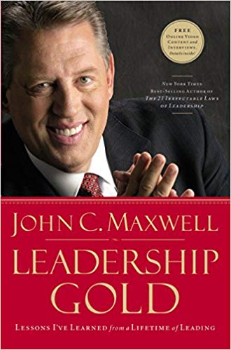
Introduction
“The toughest person to lead is always yourself.”
—John Maxwell, Leadership Gold

